Slide 1

Programming Basics
- Java programming -
01. Introduction
Wei Weng (翁 瑋)
Graduate School of Information, Production and Systems
Waseda University

Slide 2
Text book information
Book name: OnToJava Ver.3
Online version (English) available at:
http://people.csail.mit.edu/phw/OnToJava/TOC.HTML
Using only the lecture material will also be OK.
Access to material

Slide 3
1. Introduction
What is Java?
Objective of this lecture
Features of Java
Object-oriented programming language

Slide 4
What is Java ?
Java was designed for writing programs that run on computers embedded in consumer-electronic appliances, such as microwave ovens and television sets.
Java is an object-oriented programming language.
Java programs run on a wide variety of hardware platforms.
Java programs can be loaded dynamically via a network.
Java provides robust behavior feature.
Java programs can work on multiple tasks simultaneously.
Java programs automatically recycle memory.
[0003]

Slide 5
Objectives of this lecture
You should not only study and memorize, but also experience to make software and think by yourself.
You should take basic knowledge how to use programming language so that you will be able to solve problems by yourself, when you are faced with making software in the future.

Slide 6
How to evaluate
Final examination 60%
Exercise in class 40%

Slide 7
Distribution of final scores
A+ 30%
A 30%
B 20%
C 15-20%
F 0-5%

Slide 8
Functions of Java (1)
To make Java programs portable, the Java compiler translates the programs into byte code.
Byte code is neutral in that it does not employ the instruction set of any particular computer. Instead, byte code is executed by a program called a Java virtual machine.
Once a Java virtual machine has been implemented for a particular computer, that computer will run any compiled Java program. It means that any Java application will run on every machine for which a Java virtual machine has been implemented.
[0004]

Slide 9
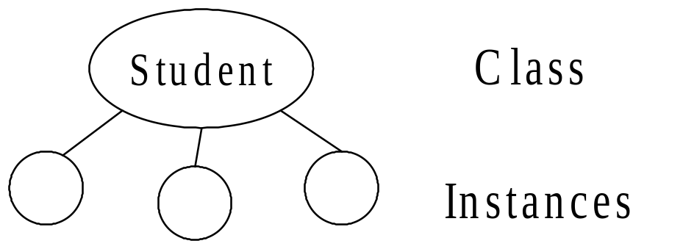
Functions of Java (2)
Java is object oriented, programs consist of class definitions.
In Java, there are some generic prepared classes, such as vectors. Other classes are defined by yourself for your applications. Once a class is defined, you can create class instances that describe the particular properties of the individuals.
[0007]

Slide 10
Functions of Java (3)
Java increases your productivity by providing automatic memory recycling. When you use a language such as C++, you have to remember to free the memory allocated to program elements, such as class instances, once you are finished with them. Failing to free memory produces a memory leak that may exhaust all the memory available to your program, leading either to erratic behavior or to a total program crash.
Java frees memory automatically, by performing automatic garbage collection, so you never need worry about memory leaks.
[0013]

Slide 11
Class and Method
All Java programs contain one or more class definitions, each of which may contain various method definitions.
method definition
method definition
class definition
class definition
Program
Java's methods take the place of the functions or procedures in other languages.
[0027]

Slide 12
Main Method
In particular, every standalone Java program must contain a class definition that defines a method named main.
When you start a Java program, the Java virtual machine performs the computations specified in the main method.
main method definition
class definition
class definition
Program
[0027]

Slide 13
An example of program
Keywords
Parameter specification
statement terminator
public class Demonstrate {
public static void main (String argv[]) {
System.out.print("The rating of the movie is "); System.out.println(6 + 9 + 8);
}
}
body
statements
Arithmetic expression
String
The semicolon, ;, the parentheses, (), and the braces, {}, act as punctuation. Occasionally, such markers, in such contexts, are called punctuators.
Spaces, tabs, line feeds, and carriage returns are said to be whitespace characters. Java treats all sequences of whitespace characters—other than those in strings—as though there were just a single space.
[0030-0050]

Slide 14
Let’s try
Execute Eclipse.
Create a project.
Create a class.
Run the program.

Slide 15
Eclipse workspace
Folders and files in the workspace
  For each project we create, Eclipse creates a folder named the project’s name in the workspace
  For each class we create, Eclipse creates a .java file in the folder named src (source code) in the folder
[0473,0474,0475]

Slide 16
Copy and import Eclipse project files
You can copy an Eclipse project folder and import it to any computer installed with Eclipse.
In this way, you can move a project with all its source code and relevant files to any computer.
Note: only copying the contents of a .java source code file sometimes creates error
[0473,0474,0475]

